Slide 1


Slide 2


Slide 3
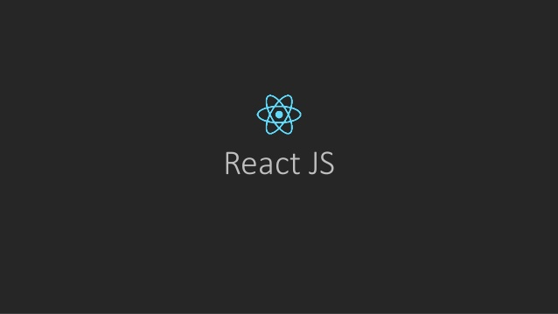


Slide 4


Slide 5
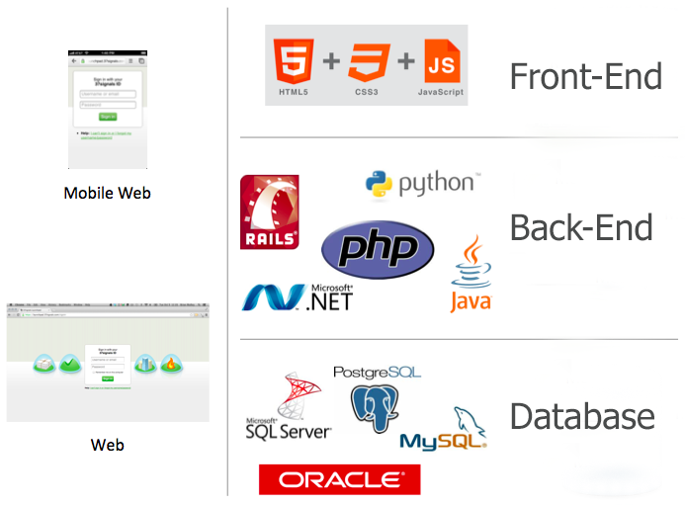

Slide 6


Slide 7
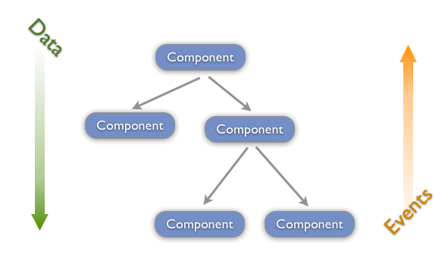
Single-Way Data Flow

Slide 8

DOM(Document Object Model)
<html>
<head>
<title>My title</title>
</head>
<body>
<h1>My header</h1>
<a href="test.html">My link</a>
</body>
</html>

Slide 9
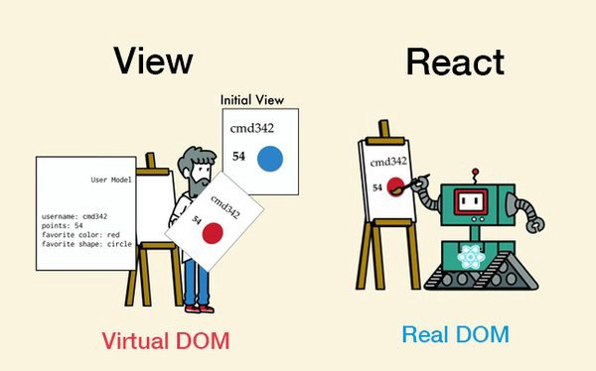
Virtual Document Object Model

Slide 10
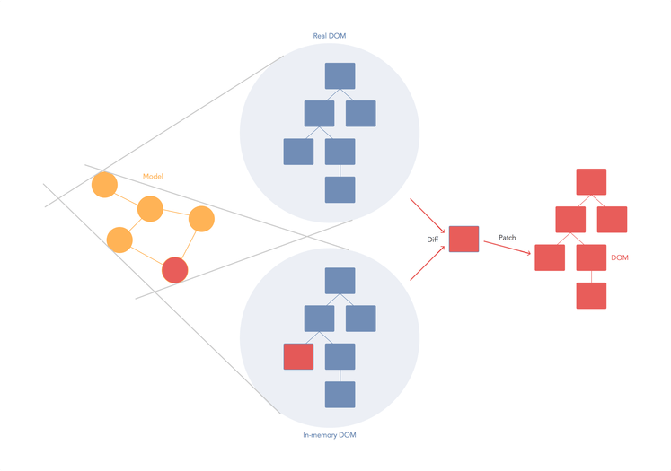

Slide 11


Slide 12





Slide 13

What is Node.js?
Node.js is an open source server framework
Node.js is free
Node.js runs on various platforms (Windows, Linux, Unix, Mac OS X, etc.)
Node.js uses JavaScript on the server

Slide 14
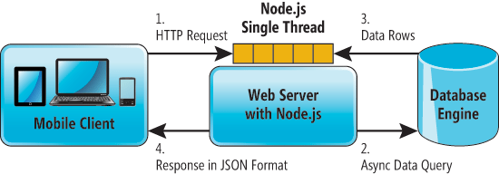

Slide 15

What is NPM(Node Package Manager)?
NPM is a package manager for Node.js packages, or modules if you like.
www.npmjs.com hosts thousands of free packages to download and use.
The NPM program is installed on your computer when you install Node.js

Slide 16
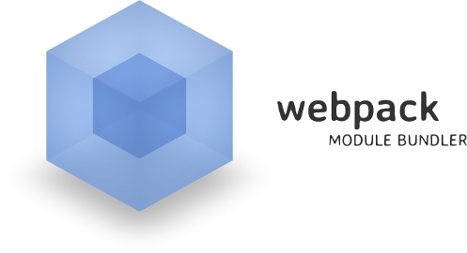
What is Webpack?
Webpack is a module bundler for modern JavaScript applications.

Slide 17
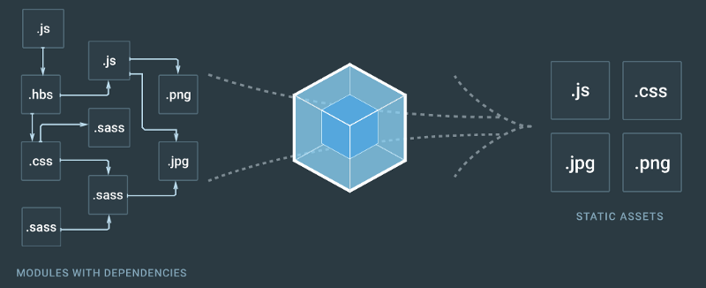

Slide 18
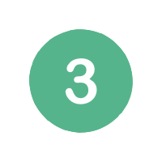




Why Webpack?
// index.js - our application logic
var totalMultiply = multiply(5, 3);
var totalSum = sum(5, 3);
console.log('Product of 5 and 3 = ' + totalMultiply);
console.log('Sum of 5 and 3 = ' + totalSum);
// sum.js
var sum = function (a, b) {
return a + b;
};
// multiply.js
var multiply = function (a, b) {
var total = 0;
for (var i = 0; i < b; i++) {
total = sum(a, total);
}
return total;
};
// index.html - our entry point to our application
<html>
<head>
<script src="src/sum.js"></script>
<script src="src/multiply.js"></script>
<script src="src/index.js"></script>
</head>
</html>
Product of 5 and 3 = 15
index.js:17 Sum of 5 and 3 = 8

Slide 19
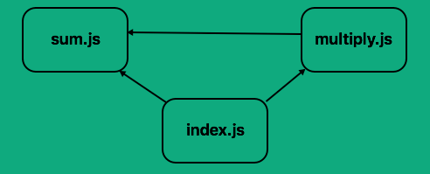
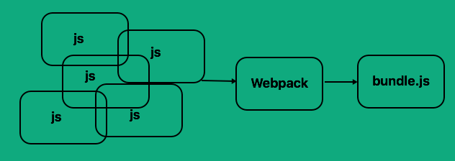

Slide 20
CommonJS From Week4(ES6 Modules)
// sum.js
var sum = function (a, b) {
return a + b;
};
module.exports = sum;
// index.js - our application logic
var multiply = require('./multiply');
var sum = require('./sum');
var totalMultiply = multiply(5, 3);
var totalSum = sum(5, 3);
console.log('Product of 5 and 3 = ' + totalMultiply);
console.log('Sum of 5 and 3 = ' + totalSum);
// multiply.js
var sum = require('./sum');
var multiply = function (a, b) {
var total = 0;
for (var i = 0; i < b; i++) {
total = sum(a, total);
}
return total;
};
module.exports = multiply;
// index.html - our entry point to our application
<html>
<head>
<script src="./dist/bundle.js""></script>
</head>
</html>

Slide 21


How To Use Webpack?
Create File & Folder Based On This Structure
├── /app/
| ├── /index.html
| ├── /multiply.js
| ├── /sum.js
| ├── /index.js
├── /dist/
├── /node_modules/
├── /webpack.config.js
├── /package.json
npm init

Slide 22
Webpack.config.js
var path = require('path');
module.exports = {
entry: './src/index.js',
output: {
path: path.resolve(__dirname, './dist/'),
filename: 'bundle.js'
}
}
Run this command

Slide 23
How to use ES6 with webpack ?

Slide 24
Ans : webpack + loader

Slide 25

Webpack + Babel

Slide 26
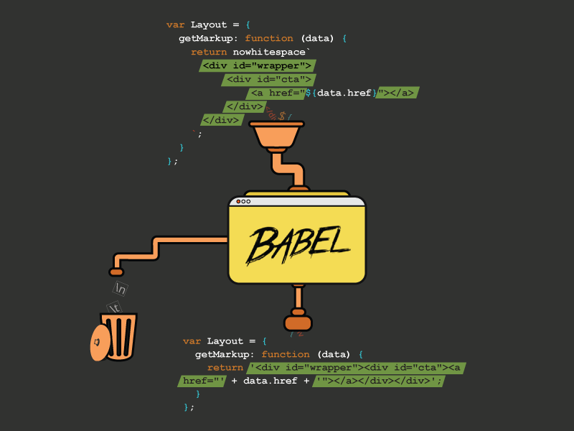

Slide 27
ES6 for build webpack
// sum.js
const sum = (a, b) => a + b;
export default sum;
// index.js - our application logic
import multiply from './multiply';
import sum from './sum';
const totalMultiply = multiply(5, 3);
const totalSum = sum(5, 3);
console.log(`Product of 5 and 3 = ${totalMultiply}`);
console.log(`Sum of 5 and 3 = ${totalSum}`);
// multiply.js
import sum from './sum';
const multiply = (a, b) => {
let total = 0;
for(let i=0;i<b;i++) {
total = sum(a, total);
}
return total;
};
export default multiply;
<!-- // index.html - our entry point to our application -->
<html>
<head>
<script src="../dist/bundle.js""></script>
</head>
</html>

Slide 28
Webpack.config.js
var path = require('path');
module.exports = {
entry: './src/index.js',
output: {
path: path.resolve(__dirname, './dist/'),
filename: 'bundle.js'
},
module: {
loaders: [
{
test: /\.js$/,
loader: 'babel-loader',
exclude: /node_modules/,
query: {
presets: ['es2015']
}
}
]
}
};

Slide 29
Run this command

Slide 30
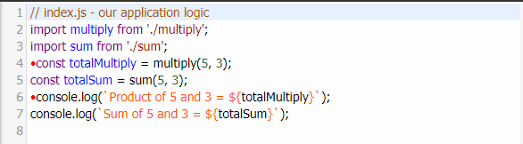
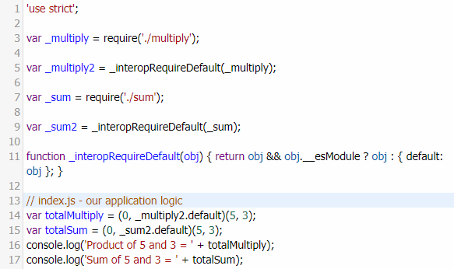
ES6 after past webpack
http://babeljs.io/repl/

Slide 31
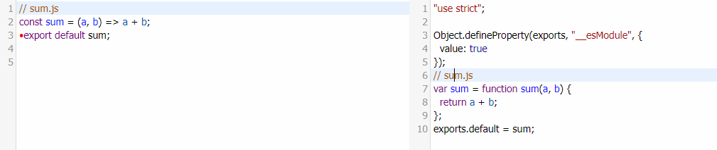
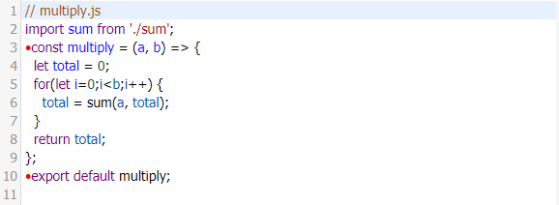
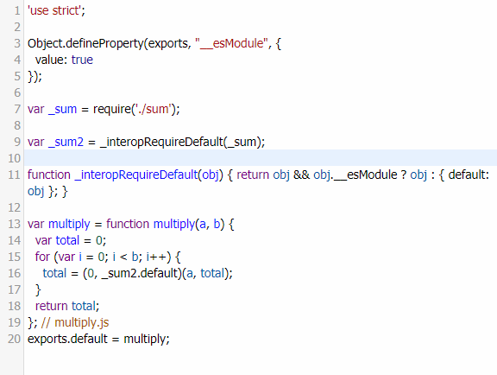

Slide 32
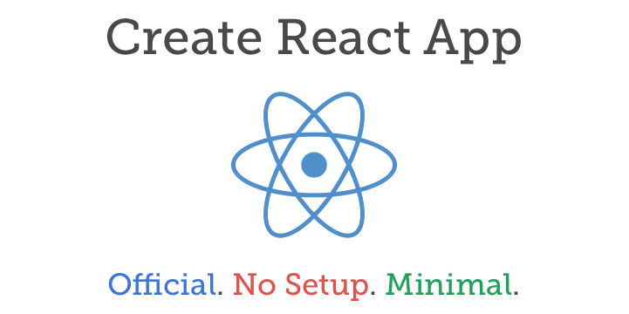
Configuration for React web development
- Setup React environment
- Polyfill JavaScript
- CSS Prefixer
- Dev Server
- build file for development and production
- Etc.

Slide 33


Slide 34
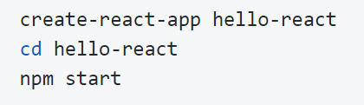
Hello World React
Then open http://localhost:3000/ to see your app.
When you’re ready to deploy to production, create a minified bundle with npm run build.

Slide 35
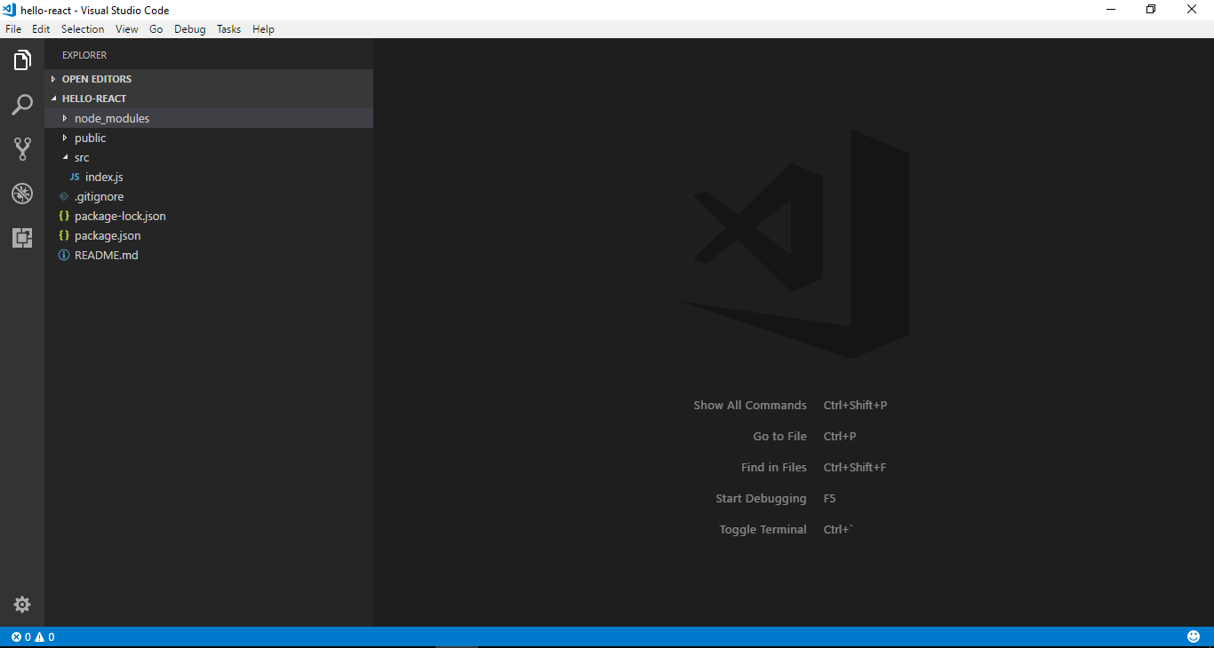
Open project in VS Code

Slide 36
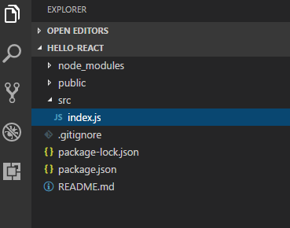
Step 1
Delete all file in src folder after that it’s like the picture below.

Slide 37
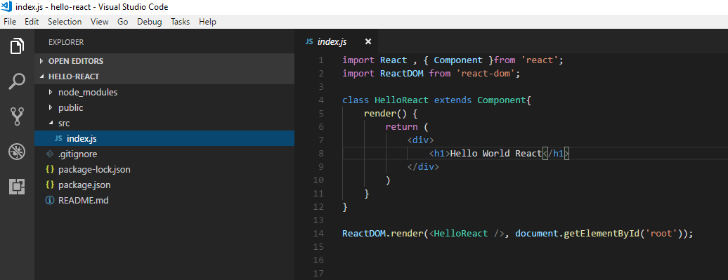
Step 2
Edit code in file index.js as show below.

Slide 38
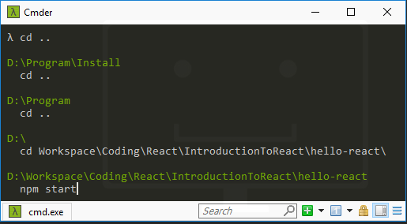
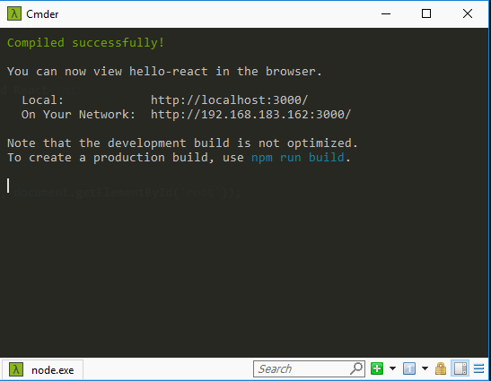
Step 3
Open Cmder and cd(Change Directory) to project path
And use “ npm start ” for run project

Slide 39
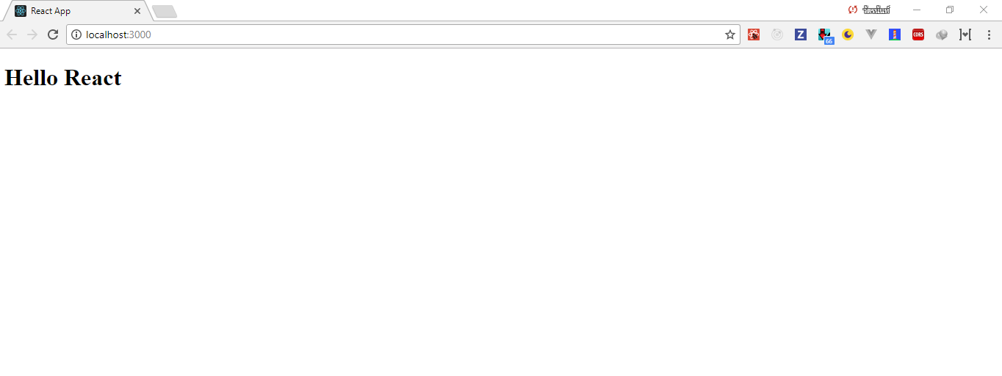
Step 4
Open web browser at http://localhost:3000/

Slide 40


Slide 41
Component
Component Let you split the UI into independent , reusable pieces , and think about each piece in isolation.
React.Component is provide by React.

Slide 42
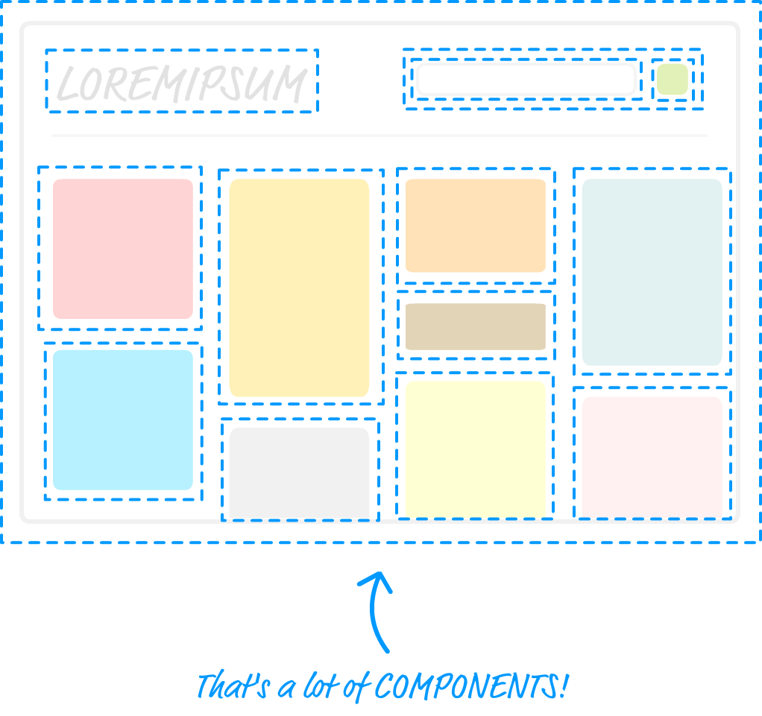
Component

Slide 43
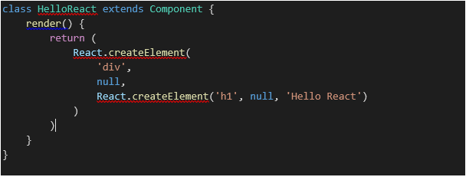
Create Component

Slide 44
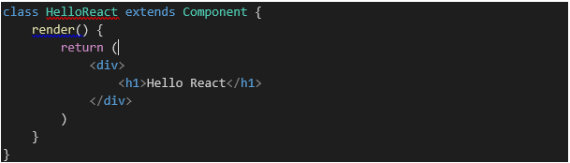
JSX : Javascript Syntax Expression
JSX is javascript combined with XML for can write Tag in javascript.
The file will have a .jsx extension.

Slide 45
Create Component
Not used JSX
Used JSX

Slide 46
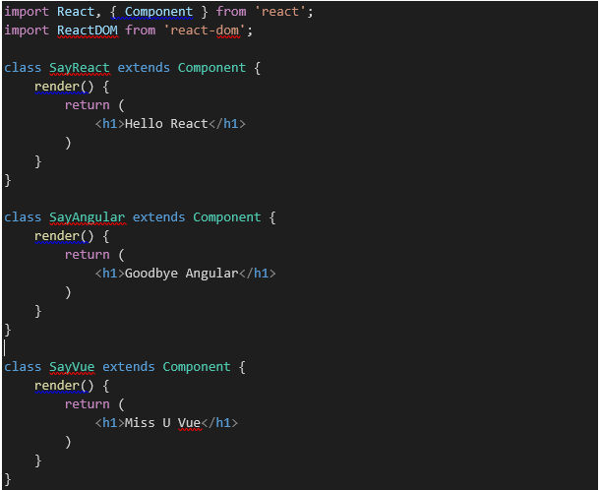
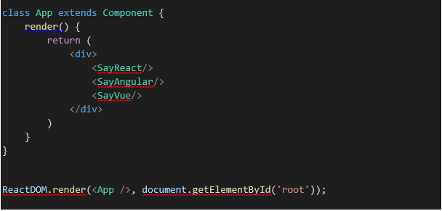
Reuse Component
App , SayReact , SayAngular , SayVue is custom tag for reusable concepts.
This tag for implementation in another page.

Slide 47


Slide 48

React Props/State Explained Through Darth Vader’s Hunt for the Rebels
If you’ve seen Star Wars, then you can understand props and state.
Here’s a spoiler-free refresher of the basic premise of episodes 4–6:
Darth Vader hunts the rebels relentlessly, as they are the last resistance against the Galactic Empire.
The rebels, led by Princess Leia and Luke Skywalker, must fight back and exploit vulnerabilities within the Empire.
Darth Vader uses a variety of tactics to try and discover the movements of the rebels, including an army of Stormtroopers, a fleet of starships, and a variety of scouts.
The entire plan for the Empire’s resources depends upon Vader’s leadership.

Slide 49

But in React, the idea is that when state is modified, the changes will automatically trickle down to all child components via props. So you only need to write the code to change one thing — the state — and watch as your UI updates.
This is similar to the way that Darth Vader commands the three wings of his army. Once word gets back to him of the rebel location, his resources will automatically mobilize to launch an attack.

Slide 50


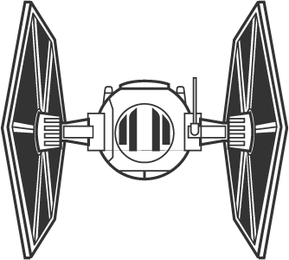
A Summary of The Galactic Empire
Here are the three wings of the Galactic Empire.
The Imperial Army
The Imperial Navy
Military Intelligence
The Imperial Army is composed of Stormtroopers, AT-ATs, AT-STs and others.
The Imperial Navy is composed of star destroyers, TIE fighters and others.
Military Intelligence is composed of bounty hunters like Boba Fett, probe droids, and any other specialized scouts.

Slide 51
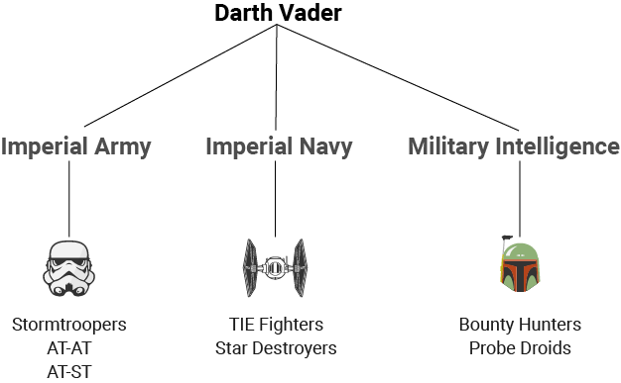
Here is a quick org chart that will give some direction on how we will write our components.
Stormtrooper encounters rebel base → Return to Darth Vader with location
User clicks certain element → Update the state of some parent component

Slide 52
Here are the basics in code, which follows the org chart above: (Vaders Empire)
class vadersEmpire extends Component{
state = {
rebelLocation: ''
};
render() {
return (
<div>
<ImperialArmy />
<ImperialNavy />
<MilitaryIntel />
</div>
);
}
}

Slide 53
Here are the basics in code, which follows the org chart above: (Imperial Army)
class ImperialArmy extends Component{
render() {
return (
<div>
<StormTrooper />
<ATAT />
<ATST />
</div>
);
}
}
class StormTrooper extends Component{
render() {
return (
<div></div>
);
}
}
class ATAT extends Component{
render() {
return (
<div></div>
);
}
}
class ATST extends Component{
render() {
return (
<div></div>
);
}
}

Slide 54
Here are the basics in code, which follows the org chart above: (Imperial Navy)
class ImperialNavy extends Component{
render() {
return (
<div>
<TIEFighter />
<StarDestroyer />
</div>
);
}
}
class TIEFighter extends Component{
render() {
return (
<div></div>
);
}
}
class StarDestroyer extends Component{
render() {
return (
<div></div>
);
}
}

Slide 55
Here are the basics in code, which follows the org chart above: (Military Intelligence)
class MilitaryIntel extends Component{
render() {
return (
<div>
<BountyHunter />
<ProbeDroid />
</div>
);
}
}
class BountyHunter extends Component{
render() {
return (
<div></div>
);
}
}
class ProbeDroid extends Component{
render() {
return (
<div></div>
);
}
}

Slide 56
State
State allows you to dynamically change many elements at once based on one variable. State encompasses the key parts of your UI that change basic on user input.
With less things to keep track of in state, you will be able to write components with more clarity and fewer opportunities for bugs. When state changes, many components may change in accordance based on the one variable.

Slide 57
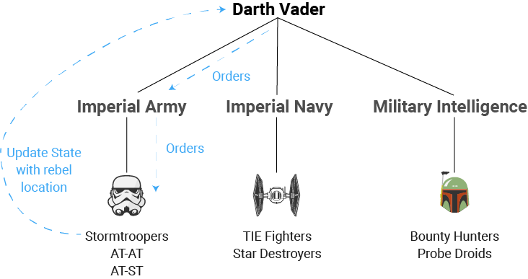
State in story
Let’s say Stormtroopers encounter the rebels. Vader has ordered them to report to him as soon as possible. Once they return with a rebel location, Vader can carry out the rest of his orders, which were contingent on the rebel location. Here is a modified diagram that charts the path through the components listed above.

Slide 58
Orders are already passed down to every member at the bottom of the chart. Once they run into rebels, they know to return to Lord Vader. The rebelLocation state will then be updated with the planet, be it “Endor”, “Hoth”, or somewhere else.
Above: Stormtrooper nested within ImperialArmy nested within vadersEmpire
In a real app: User input nested within parent div nested within parent div

Slide 59
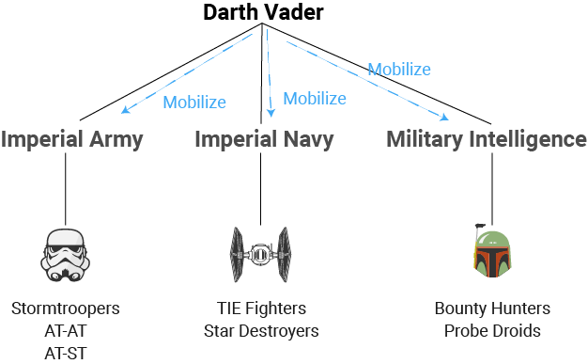
What happens when state changes
In this case, once the rebelLocation is discovered, the state would change to that planet. But that is only half the story. Darth Vader would have plans in mind to mobilize different assets based on this state change. He can prepare them in advance for this possibility. As in, “When we find their planet, travel there immediately and prepare for an assault!”
Once state changes, the changes are automatically shared with all 3 wings of the Empire. Similarly, when the state of a parent component changes, the child components automatically inherit the new state.

Slide 60
Every component can also have its own state. For example, the ImperialArmy component might have a troopsCount state which counts the members of the army. We will not modify that in this example, but you can imagine that a battle might affect troopsCount.
Notice how this state does not depend on rebelLocation. If it did, we would not want to explicitly declare another state. We would want it to automatically update based on a change in rebelLocation state.
Since it is independent, here is what the code looks like:
class ImperialArmy extends Component{
state = {
troopCount: 0
};
render() {
return (
<div>
<StormTrooper />
<ATAT />
<ATST />
</div>
);
}
}

Slide 61
Wait, so how does this state get communicated between the different components? That brings us to… props!

Slide 62
Props
With our Darth Vader case, we actually need two sets of instructions when it comes to commanding the Stormtroopers and other units on the bottom of our chart.
Question 1: What should the Stormtroopers do if they encounter the rebels?
Answer: Report back to Darth Vader.
Question 2: Where should the Stormtroopers travel?
Answer: if the rebels have not been found, search the galaxy at random. Else, go to the rebel location to attack them.
Props allow us to continuously monitor the rebelLocation state, and order a troop movement if the state changes. rebelLocation is a string. But what about the orders that must happen when they initially find the rebels?

Slide 63
We can actually pass a function as props as well! That means that we can pass a callback down to each Stormtrooper that will execute if that trooper discovers the target. In the following picture, you can follow the path outlined by “Orders” to trace the props.
In a typical user interface, let’s say that a user clicks a button, and you want to update the state of a parent component. You must also pass a callback from that parent component that will be triggered on the user’s click. That callback can then update the state because it originated with the same parent that set the state.

Slide 64
Here is what the code looks like:
class ImperialArmy extends Component {
render() {
return (
<div>
<StormTrooper
rebelLocation={this.props.rebelLocation}
updateLocation={this.props.updateLocation}
/>
<ATAT />
<ATST />
</div>
)
}
}
class StormTrooper extends Component {
discoverLocation() {
this.props.updateLocation(
this.refs.secretBaseLocation.value
);
};
render() {
return (
<input
placeholder = {this.props.rebelLocation}
value = ''
onChange = {this.discoverLocation}
ref="secretBaseLocation"
/>
)
}
}
class vadersEmpire extends Component {
state = {
rebelLocation: ''
};
reportRebelLocation(newLocation) {
this.setState({
rebelLocation: newLocation
});
};
render() {
return (
<div>
<ImperialArmy
rebelLocation={this.state.rebelLocation}
updateLocation={this.reportRebelLocation}
/>
<ImperialNavy />
<MilitaryIntel />
</div>
);
}
}

Slide 65



Homework
Convert resume(html + css) from homework week2 to react.js
Push this homework to repository your self & repository subject

Slide 66
Reference
https://nodejs.org/en/
https://www.npmjs.com/
https://webpack.github.io/
https://reactjs.org/
https://devahoy.com/posts/getting-started-with-nodejs/
https://stories.sellsuki.co.th/webpack-ทำงานยังไง-ไม่รู้ถือว่าบาป-7dd38131a78f
https://medium.freecodecamp.org/react-props-state-explained-through-darth-vaders-hunt-for-the-rebels-8ee486576492
React: Functional Web Development with React and Redux 1st Edition, Kindle Edition

